Slide 1
CrossKD: Cross-Head Knowledge Distillation for Object Detection CVPR 2024
Jiabao Wang
Yuming Chen
Zhaohui Zheng
Xiang Li
Ming-Ming Cheng
Qibin Hou

Slide 2
Outline
Introduction
Related Work
Method
Experiment
Conclusion

Slide 3
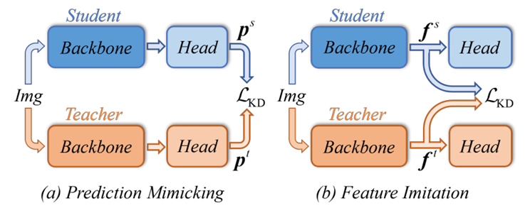
Background
Existing KD methods can be roughly classified into two categories
Prediction mimicking
Feature imitation

Slide 4
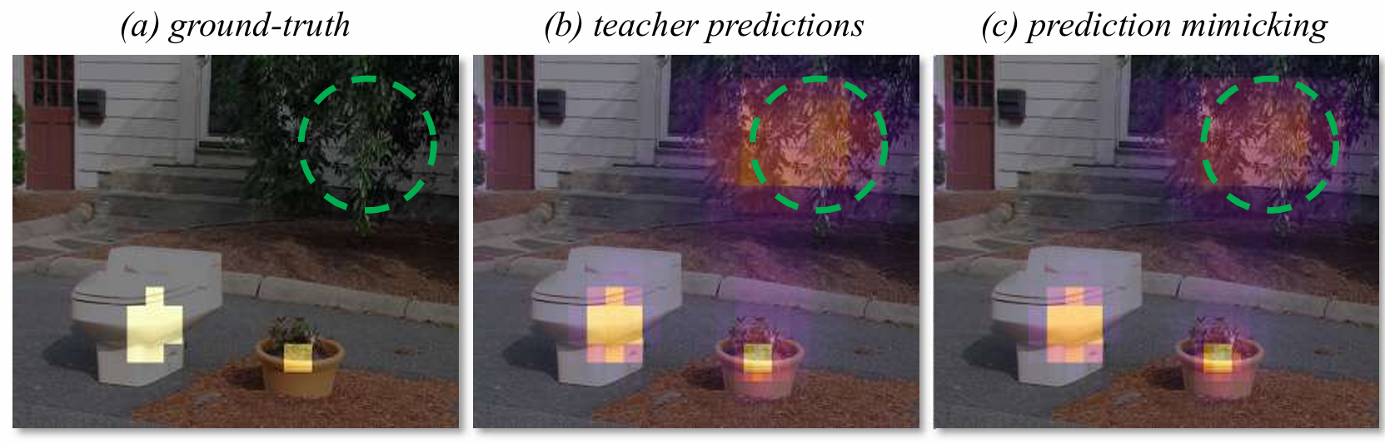
Prediction Mimicking & Target Conflict
Forcing the student to resemble the prediction distribution of the teacher
May suffer from a conflict between ground-truth and distillation target
Notes:
這些顏色是 分類預測（Classification Predictions）的信心度熱點圖。
顏色深淺/亮度： 代表模型對該區域存在目標物（如馬桶、盆栽）的信心分數。通常越偏向黃色/白色代表信心值越高，越偏向紫色/透明代表信心值越低。
各子圖的差異：
(a) Ground-truth： 理想狀態，只有在真正物體的位置才有亮點。
(b) Teacher predictions： 教師模型的預測。注意綠色圓圈處，老師模型在樹叢中產生了「誤判」或「雜訊」（有亮色塊），這就是論文提到的 Discrepancy (差異/矛盾)。
(c) Prediction Mimicking： 傳統蒸餾方法。可以看到學生模型「被迫」模仿老師，導致綠色圓圈處也出現了不該有的亮點（模仿了老師的錯誤）。
(d) CrossKD： 該論文提出的方法。成功「平滑」了模仿過程，在綠色圓圈處保持乾淨，更接近 Ground-truth，同時又學到了老師對真實目標的特徵提取能力。
GFL (Generalized Focal Loss) 是一種針對目標檢測改進的 Loss Function，主要為了解決傳統檢測框架（如 FCOS, ATSS 等）中「分類分數」與「定位質量」不一致的問題。
GFL 的核心功能：
打破離散標籤： 傳統分類用的是 0 或 1。GFL 允許分類目標是一個 連續的數值 (0~1)，通常這個數值與預測框的 IoU (交併比) 相關。
融合質量預測： 它將「這個東西是什麼（Classification）」和「這個框準不準（Localization Quality）」合二為一。
處理邊界框的機率分佈： 傳統回歸只給出一個 $x, y, w, h$ 的值，但 GFL 會去預測邊界框位置的 機率分佈。當邊界模糊時（例如被遮擋的物體），分佈會變得很分散；邊界清晰時，分佈會變得很集中（高斯分佈狀）。

Slide 5
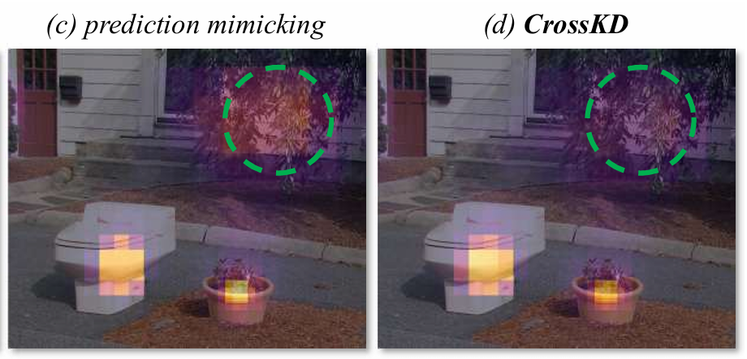
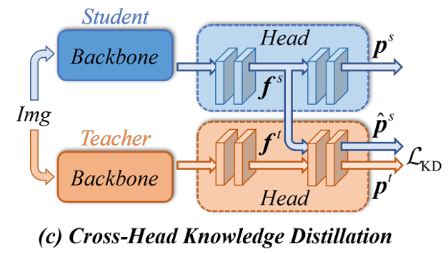
Idea of CrossKD
[13, 19, 74] tend to conduct the distillation within regions containing mediate teacher-student discrepancies
CrossKD argues that the heavily uncertain regions generally accommodate more information that benefits the student

Slide 6
Advantages
The cross-head prediction are relatively consistent with the teacher’s predictions since both are produced by teacher’s detection head
Prediction mimicking is theoretically optimal and can offer more task-oriented information compared with feature imitation

Slide 7
Outline
Introduction
Related Work
Method
Experiment
Conclusion

Slide 8
Object Detection
YOLOv1[48] let dense object detectors received great attention
YOLO series detectors [2, 16, 43, 48-50] attempt to balance the model size and accuracy
Anchor-free detectors [27, 56, 75] attempt to discard the design of anchor boxes to avoid time-consuming box operations and cumbersome hyper-parameter tuning
Dynamic label assignment methods [15, 46, 69] are proposed to better define the positive and negative samples for learning
GFL [34, 35] introduces Quality Focal Loss (QFL) and a Distribution-Guided Quality Predictor to increase the consistency between the classification score and the localization quality
Recently, due to the strong ability of the transformer block to encode expressive features, DERT family [4, 6, 30, 41, 44, 67, 76] has become a new trend in the object detection

Slide 9
KD for Object Detection
[7] proposed the first distillation framework for object detection by simply combining feature imitation and prediction mimicking
[13, 25, 33, 60] focus on selecting effective distillation regions for better feature imitation
[19, 31, 74] focus on weighting the imitation loss better
[5, 64, 65, 68] attempting to design new teacher-student consistency functions, aiming to explore more consistency information or release the strict limit of the MSE loss
Rank Mimicking [31] regards the score rank of the teacher as a kind of knowledge and aims to force the student to rank instances as the teacher
LD [73] proposes to distill the localization distribution of bounding box to transfer localization knowledge

Slide 10
Outline
Introduction
Related Work
Method
Experiment
Conclusion

Slide 11
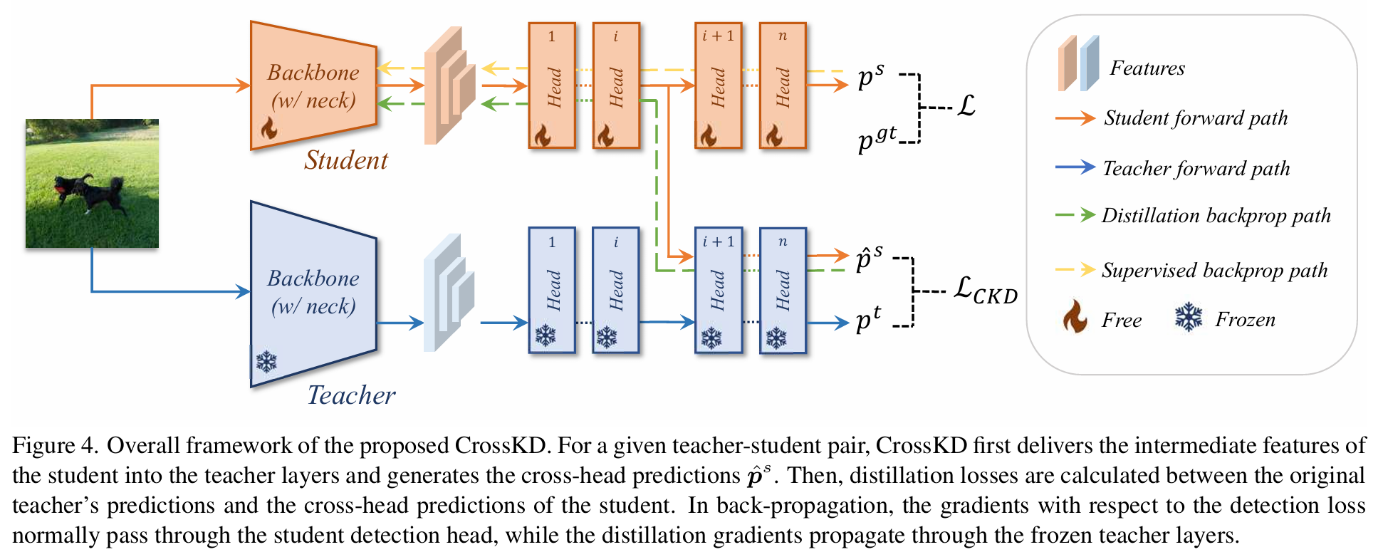
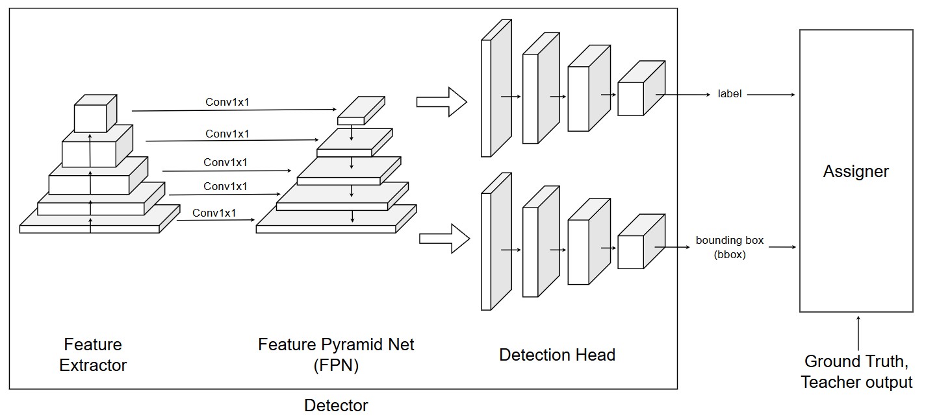
Structure Illustration

Slide 12
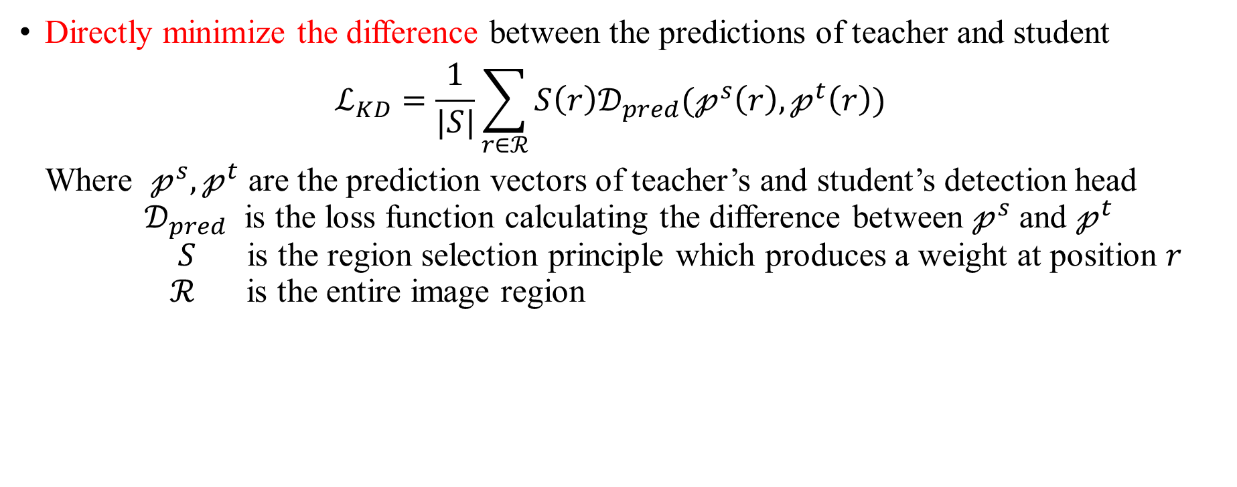
Conventional Prediction Mimicking
Directly minimize the difference between the predictions of teacher and student $ℒ_{KD}=\frac{1}{|S|}\sum_{r∈ℛ}{S\left(r\right)𝒟_{pred}(𝓅^{s}\left(r\right), 𝓅^{t}\left(r\right))}$ Where $𝓅^{s}, 𝓅^{t}$ are the prediction vectors of teacher’s and student’s detection head $𝒟_{pred}$ is the loss function calculating the difference between $𝓅^{s}$ and $𝓅^{t}$ $S$ is the region selection principle which produces a weight at position $r$ $ℛ$ is the entire image region

Slide 13
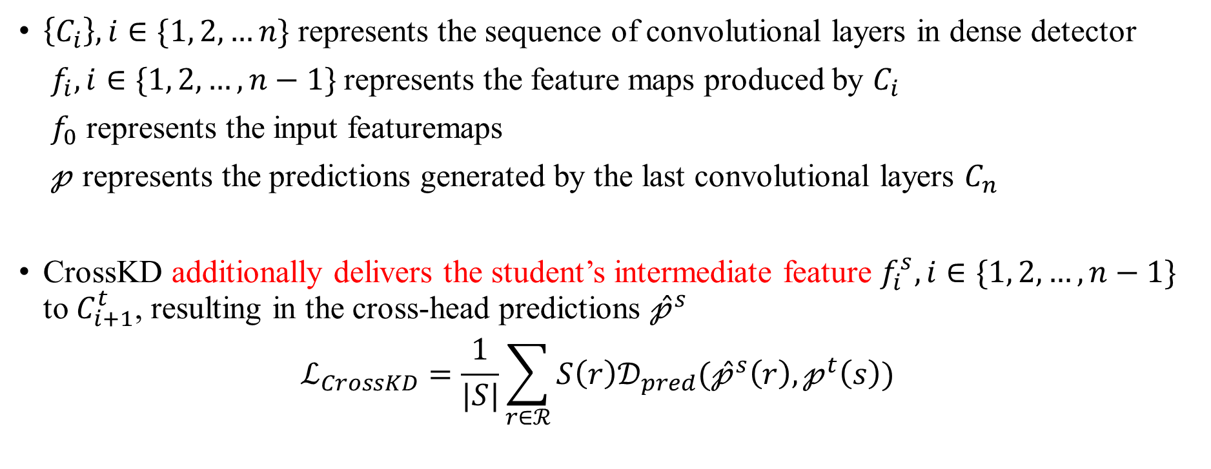
Cross-Head Knowledge Distillation
$\left\{C_{i}\right\}, i∈\{1, 2, …n\}$ represents the sequence of convolutional layers in dense detector
$f_{i}, i∈\{1, 2, …, n−1\}$ represents the feature maps produced by $C_{i}$
$f_{0}$ represents the input featuremaps
$𝓅$ represents the predictions generated by the last convolutional layers $C_{n}$
CrossKD additionally delivers the student’s intermediate feature $f_{i}^{s}, i∈\{1, 2, …, n−1\}$ to $C_{i+1}^{t}$, resulting in the cross-head predictions ${\hat{𝓅}}^{s}$ $ℒ_{CrossKD}=\frac{1}{|S|}\sum_{r∈ℛ}{S\left(r\right)𝒟_{pred}({\hat{𝓅}}^{s}\left(r\right), 𝓅^{t}\left(s\right))}$

Slide 14
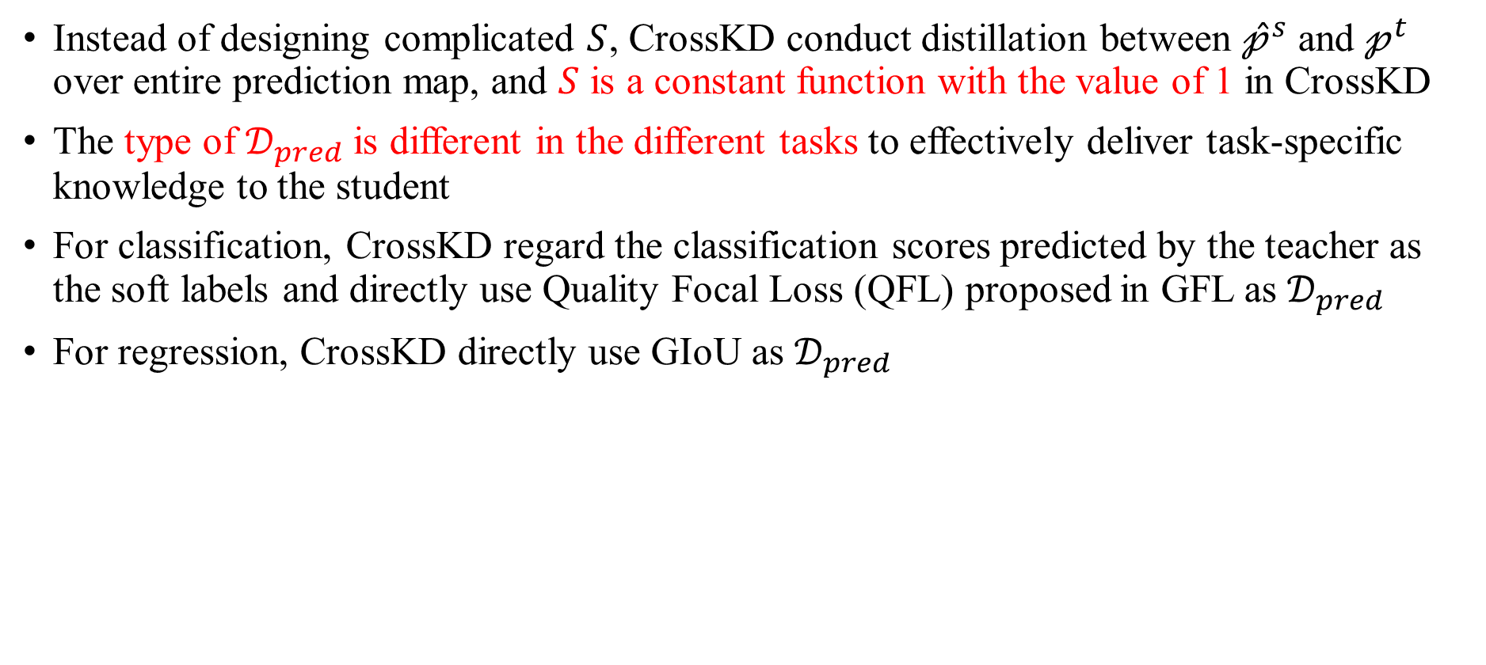
Cross-Head Knowledge Distillation
Instead of designing complicated $S$, CrossKD conduct distillation between ${\hat{𝓅}}^{s}$ and $𝓅^{t}$ over entire prediction map, and $S$ is a constant function with the value of 1 in CrossKD
The type of $𝒟_{pred}$ is different in the different tasks to effectively deliver task-specific knowledge to the student
For classification, CrossKD regard the classification scores predicted by the teacher as the soft labels and directly use Quality Focal Loss (QFL) proposed in GFL as $𝒟_{pred}$
For regression, CrossKD directly use GIoU as $𝒟_{pred}$

Slide 15
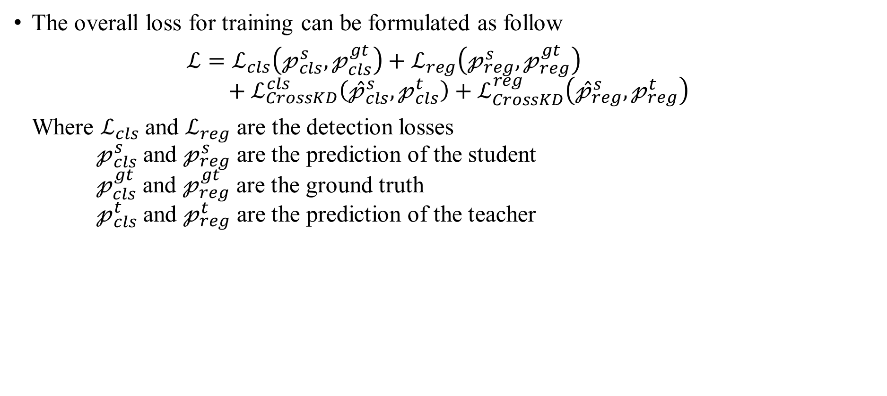
Cross-Head Knowledge Distillation
The overall loss for training can be formulated as follow $ℒ=ℒ_{cls}\left(𝓅_{cls}^{s}, 𝓅_{cls}^{gt}\right)+ℒ_{reg}\left(𝓅_{reg}^{s},𝓅_{reg}^{gt}\right)$ $+ℒ_{CrossKD}^{cls}\left({\hat{𝓅}}_{cls}^{s}, 𝓅_{cls}^{t}\right)+ℒ_{CrossKD}^{reg}\left({\hat{𝓅}}_{reg}^{s}, 𝓅_{reg}^{t}\right)$ Where $ℒ_{cls}$ and $ℒ_{reg}$ are the detection losses $𝓅_{cls}^{s}$ and $𝓅_{reg}^{s}$ are the prediction of the student $𝓅_{cls}^{gt}$ and $𝓅_{reg}^{gt}$ are the ground truth $𝓅_{cls}^{t}$ and $𝓅_{reg}^{t}$ are the prediction of the teacher

Slide 16
Outline
Introduction
Related Work
Method
Experiment
Conclusion

Slide 17
Settings
COCO trainval135k dataset (115k images) for training
COCO minival set (5k images) for validating
Average Precision (AP) for small, medium and large objects, as well as mAP with IoU threshold of 0.5 and 0.75 as metrics
All experiment are developed using 8 V100 GPUs

Slide 18
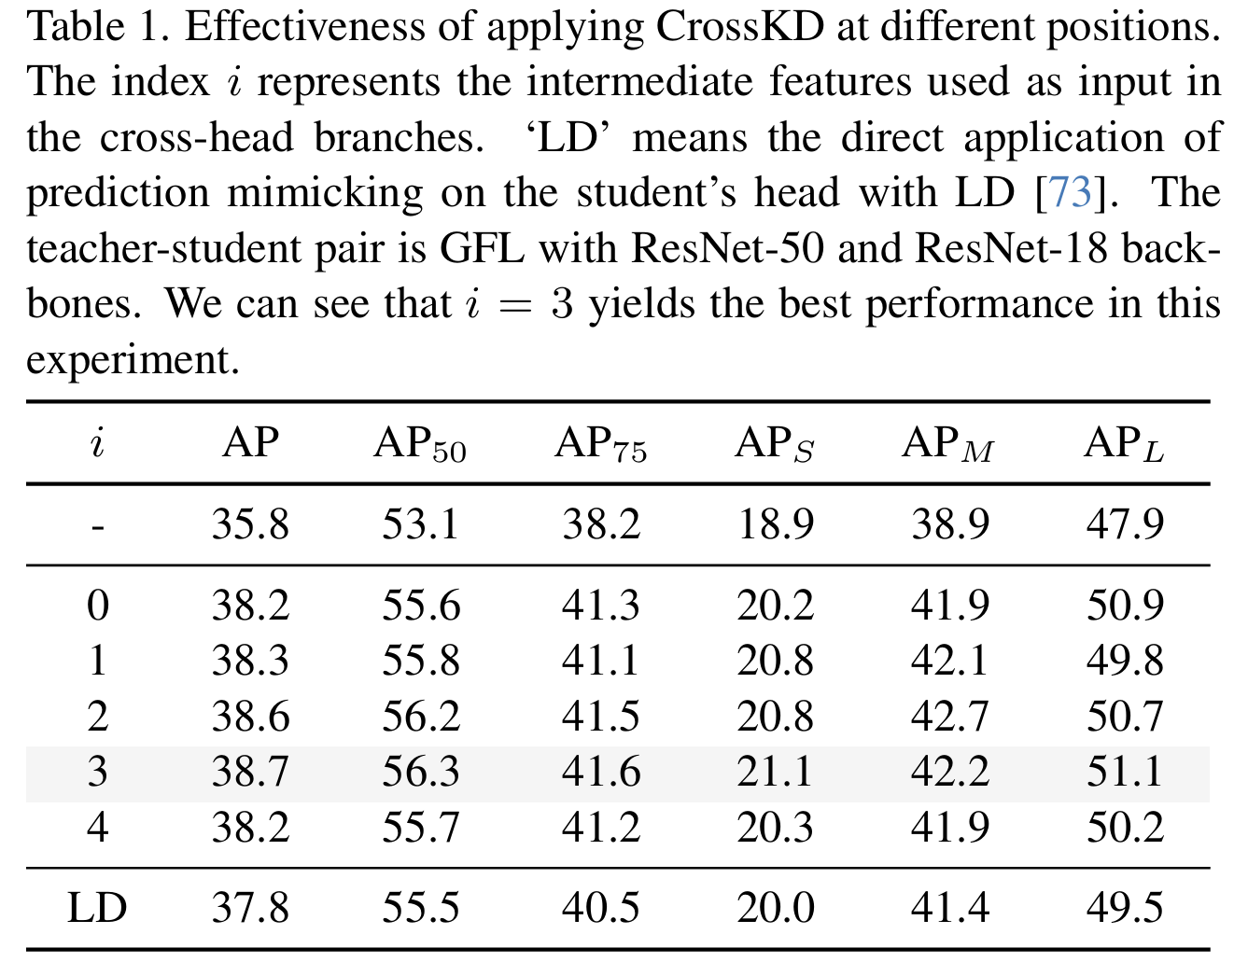

Layer of detection head to apply CrossKD
Conduct on both classification and box regression branches
CrossKD can improve the performance with any layer of detection head
Since $i$=3 has best performance, it’s the default setting in all subsequent experiments
Notes:
模型會輸出多個預測
Top-1 是指拿模型最有信心的預測去計算accuracy
Top-5 是指拿模型前五名的預測去計算accuracy，只要ground truth有在前五名就算對
Feature KD中，MGD可以接近SOTA
如果結合 logit KD的WSLD，則performance會再進一步提升

Slide 19
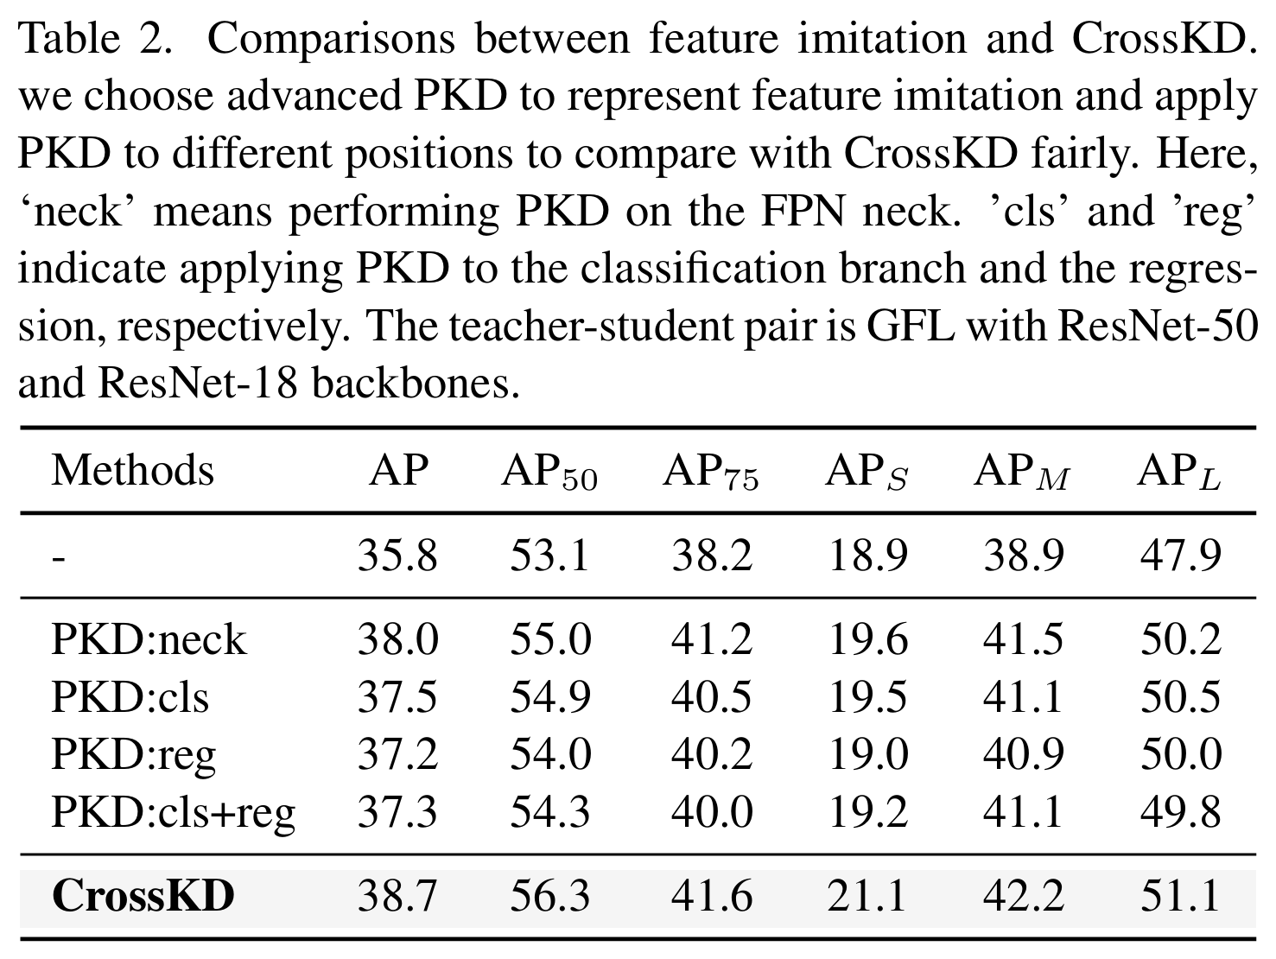
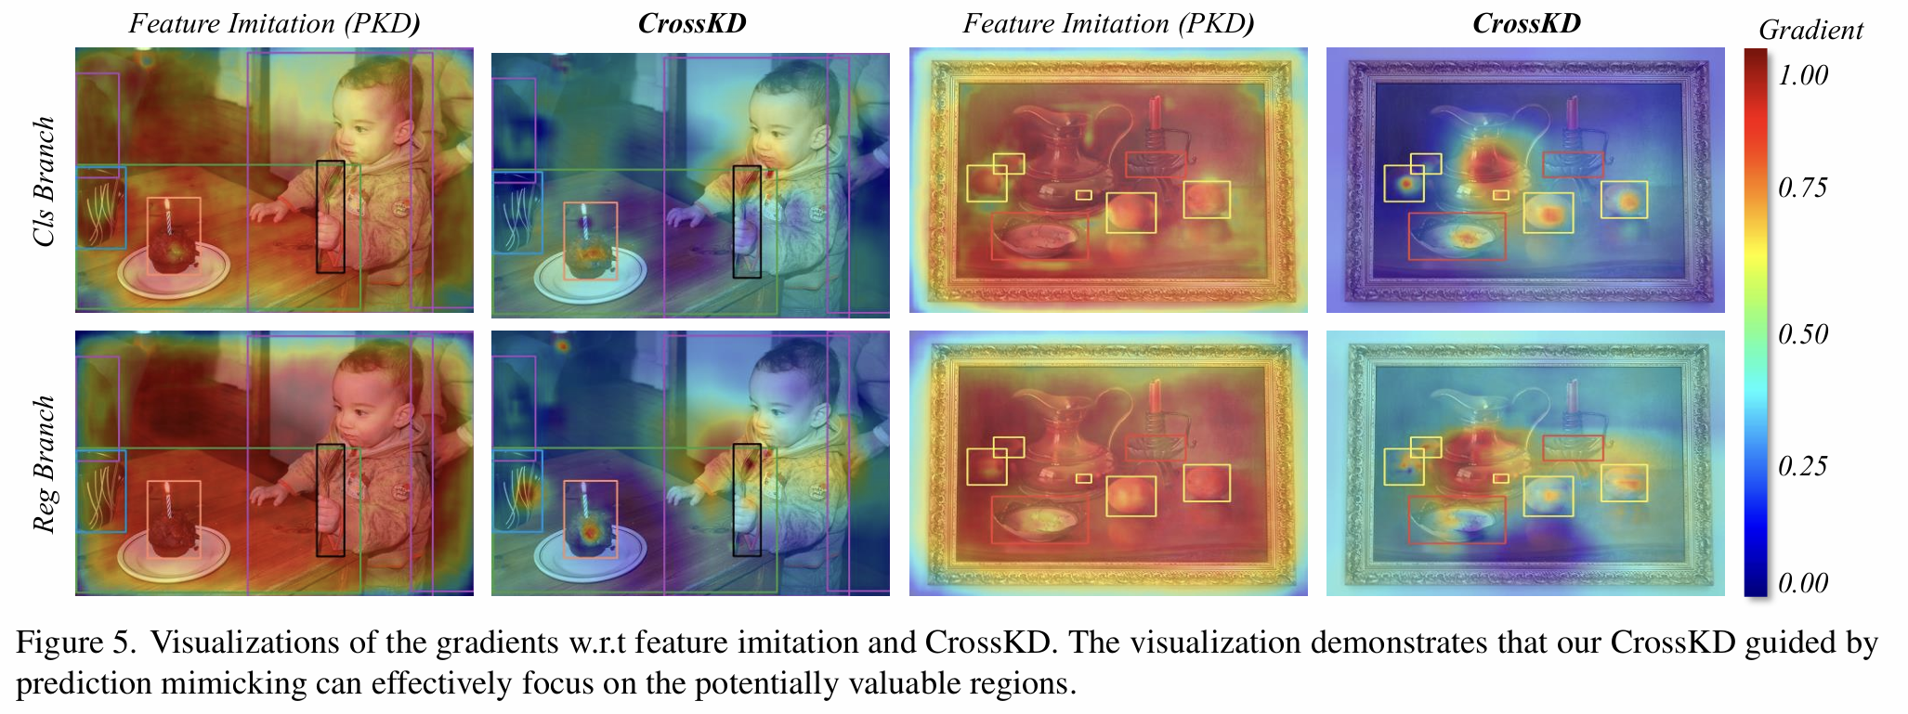
CrossKD v.s. Feature Imitation
Compared with PKD [5] on the same position (3rd layer of detection head)
Notes:
模型會輸出多個預測
Top-1 是指拿模型最有信心的預測去計算accuracy
Top-5 是指拿模型前五名的預測去計算accuracy，只要ground truth有在前五名就算對
Feature KD中，MGD可以接近SOTA
如果結合 logit KD的WSLD，則performance會再進一步提升

Slide 20
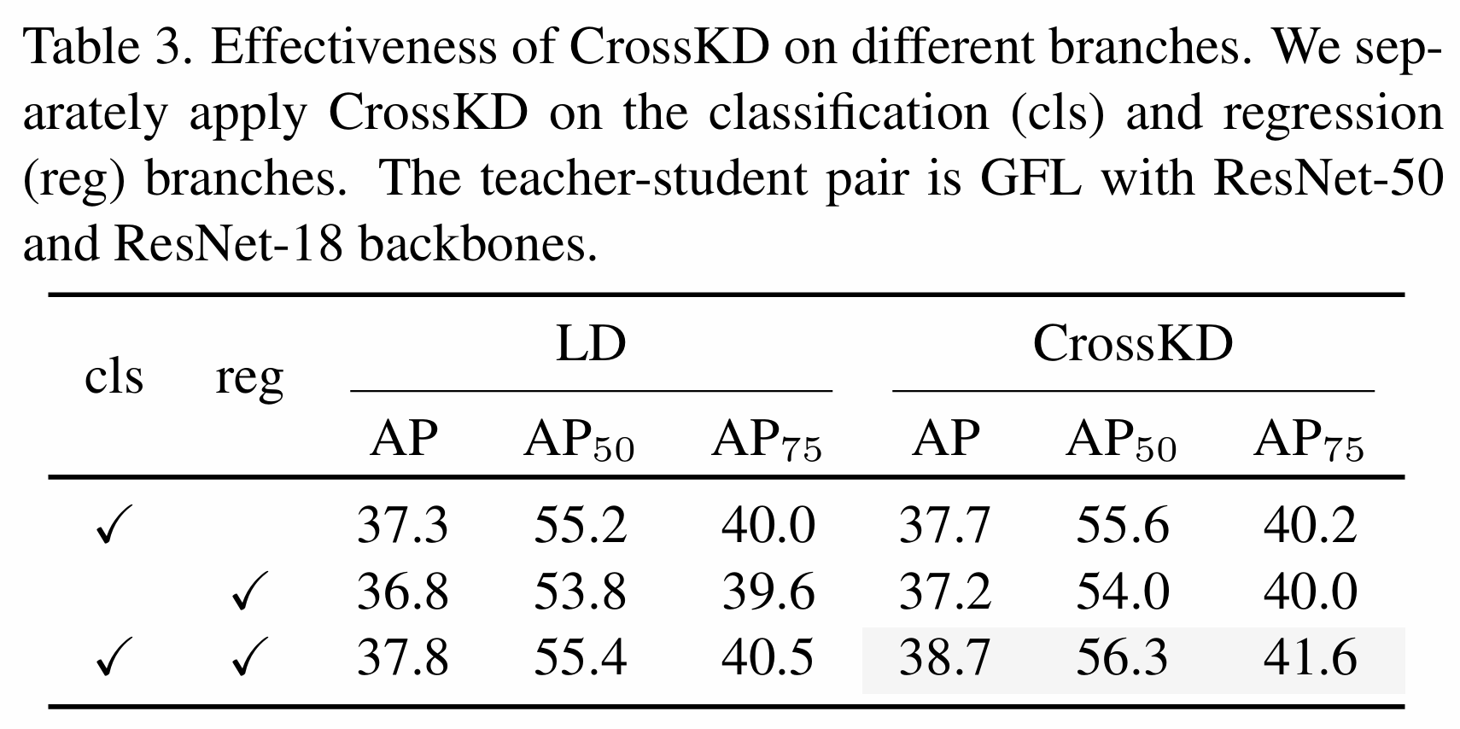
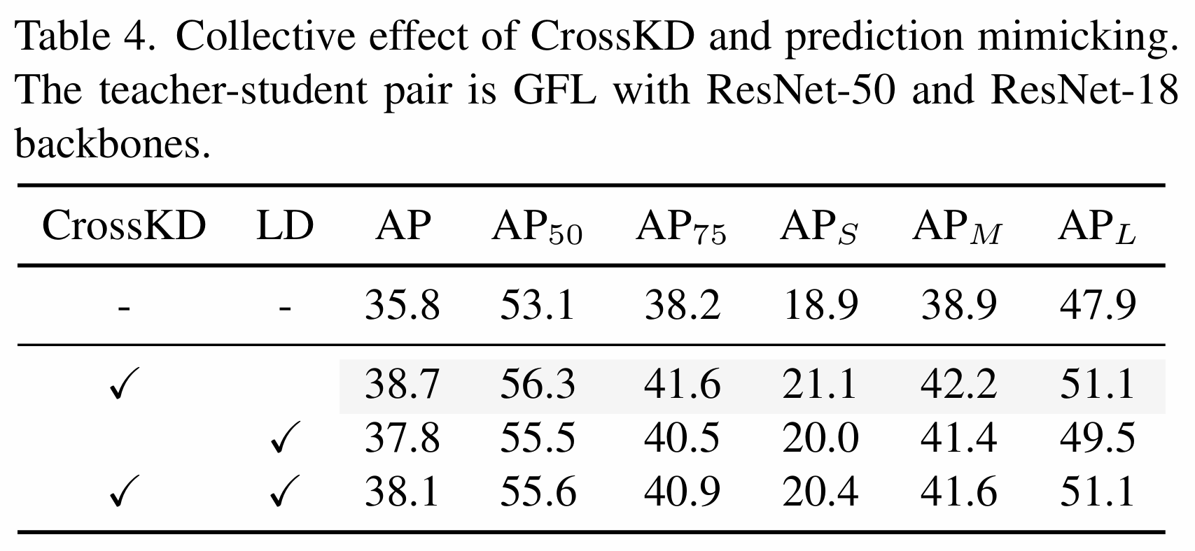
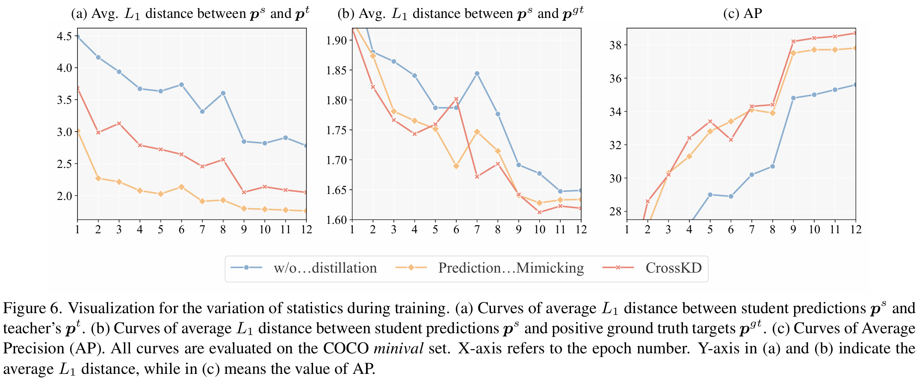
CrossKD v.s. Prediction Mimicking
Notes:
模型會輸出多個預測
Top-1 是指拿模型最有信心的預測去計算accuracy
Top-5 是指拿模型前五名的預測去計算accuracy，只要ground truth有在前五名就算對
Feature KD中，MGD可以接近SOTA
如果結合 logit KD的WSLD，則performance會再進一步提升

Slide 21
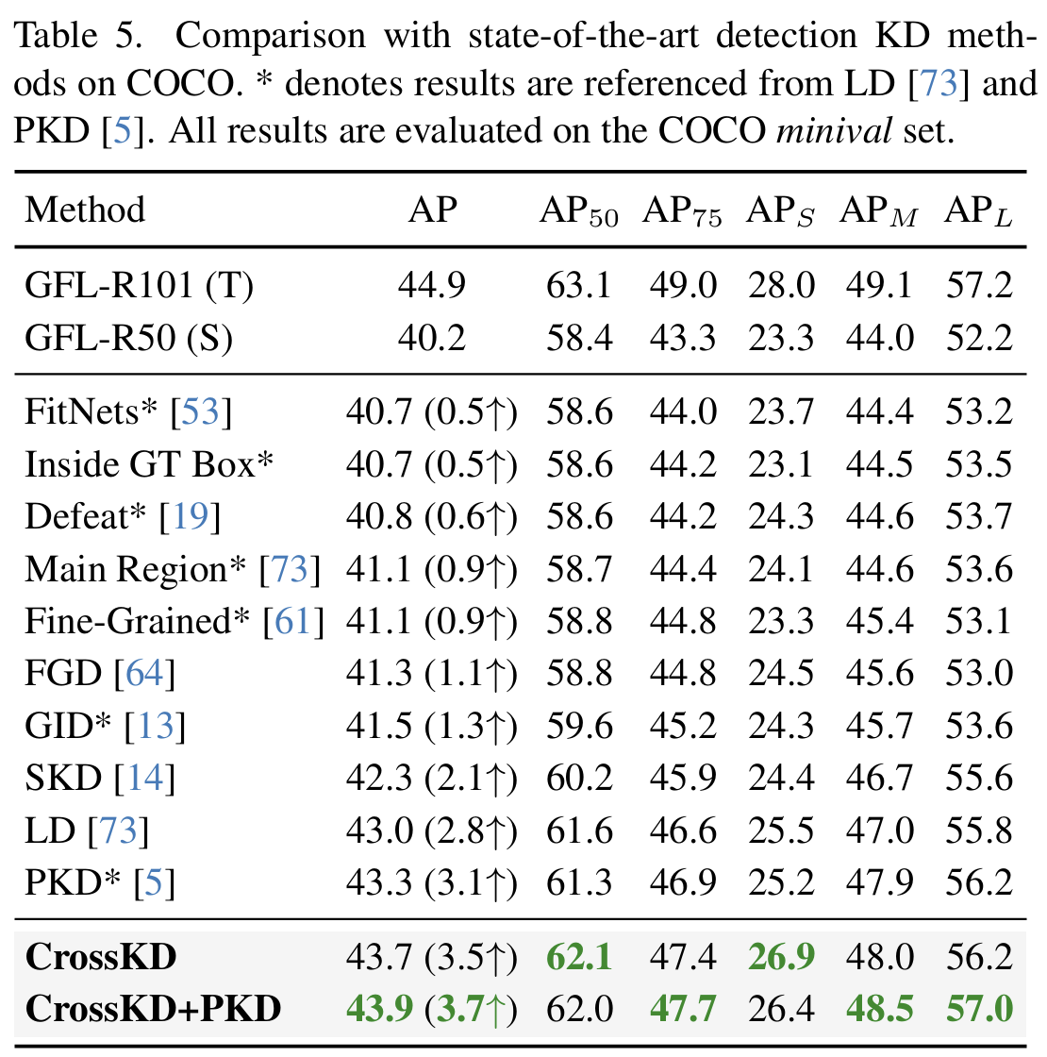
CrossKD v.s. SOTA KD Methods
Notes:
模型會輸出多個預測
Top-1 是指拿模型最有信心的預測去計算accuracy
Top-5 是指拿模型前五名的預測去計算accuracy，只要ground truth有在前五名就算對
Feature KD中，MGD可以接近SOTA
如果結合 logit KD的WSLD，則performance會再進一步提升

Slide 22
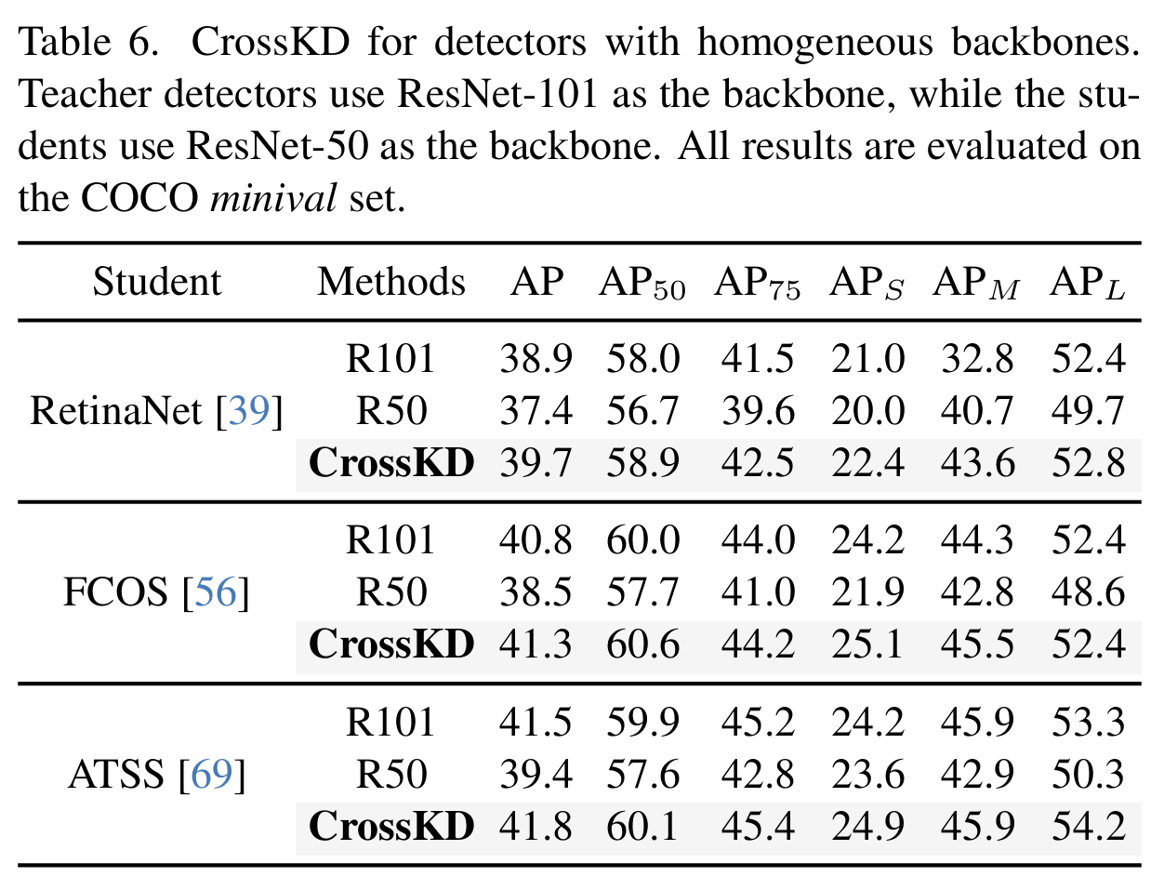
CrossKD on Different Detectors
Notes:
模型會輸出多個預測
Top-1 是指拿模型最有信心的預測去計算accuracy
Top-5 是指拿模型前五名的預測去計算accuracy，只要ground truth有在前五名就算對
Feature KD中，MGD可以接近SOTA
如果結合 logit KD的WSLD，則performance會再進一步提升

Slide 23
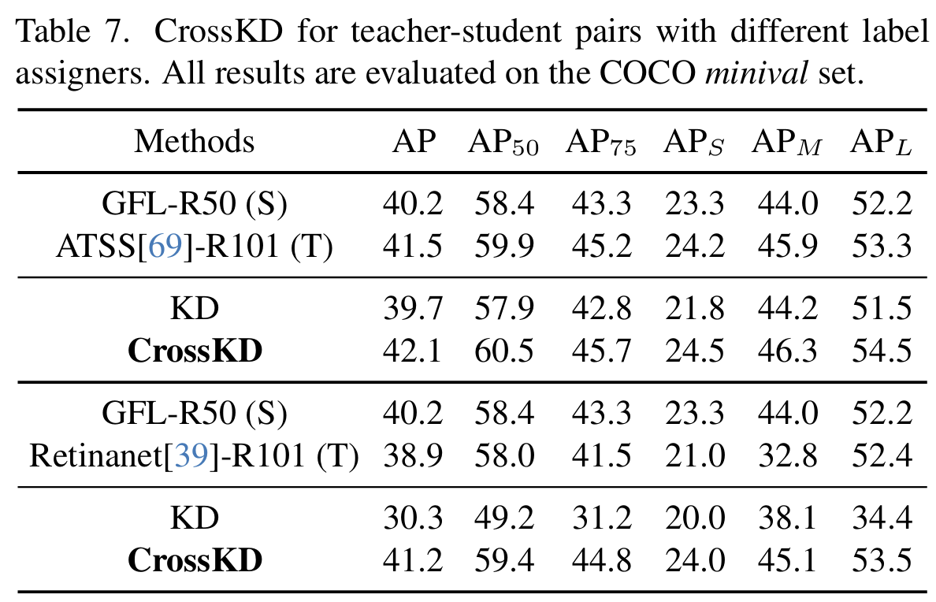
CrossKD under Severe Target Conflict
Notes:
模型會輸出多個預測
Top-1 是指拿模型最有信心的預測去計算accuracy
Top-5 是指拿模型前五名的預測去計算accuracy，只要ground truth有在前五名就算對
Feature KD中，MGD可以接近SOTA
如果結合 logit KD的WSLD，則performance會再進一步提升

Slide 24
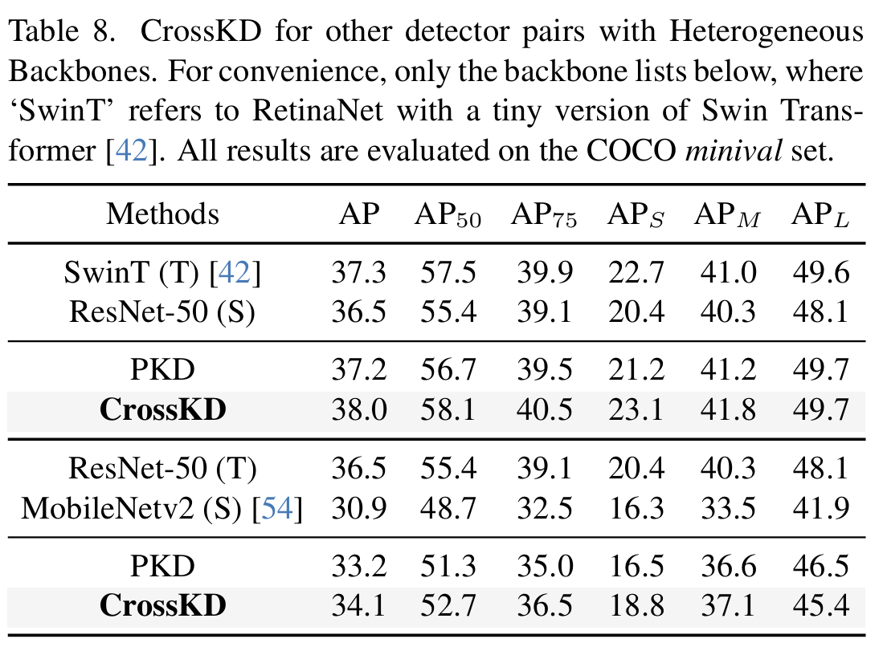
CrossKD between Heterogeneous Backbones
Notes:
模型會輸出多個預測
Top-1 是指拿模型最有信心的預測去計算accuracy
Top-5 是指拿模型前五名的預測去計算accuracy，只要ground truth有在前五名就算對
Feature KD中，MGD可以接近SOTA
如果結合 logit KD的WSLD，則performance會再進一步提升

Slide 25
Outline
Introduction
Related Work
Method
Experiment
Conclusion

Slide 26
Conclusion
Introduce CrossKD, a novel KD method designed to enhance the performance of dense object deteectors
It provides an efficient way to alleviate the conflict between the supervised and distillation targets and achieve SOTA

Slide 27
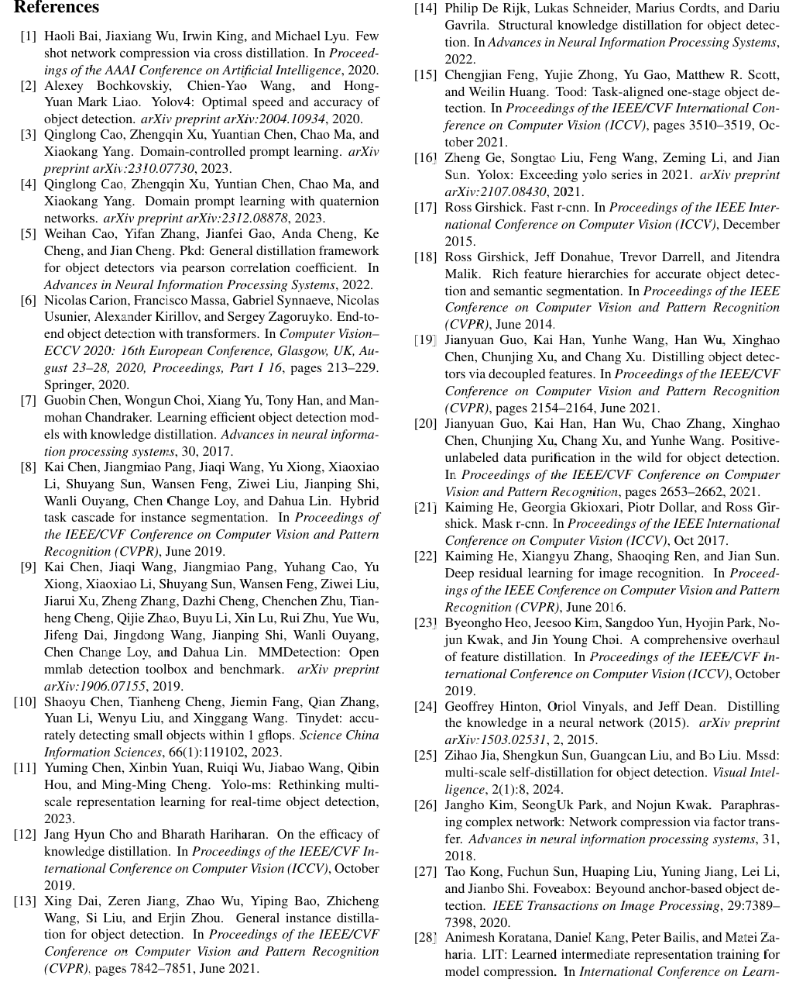
Reference

Slide 28
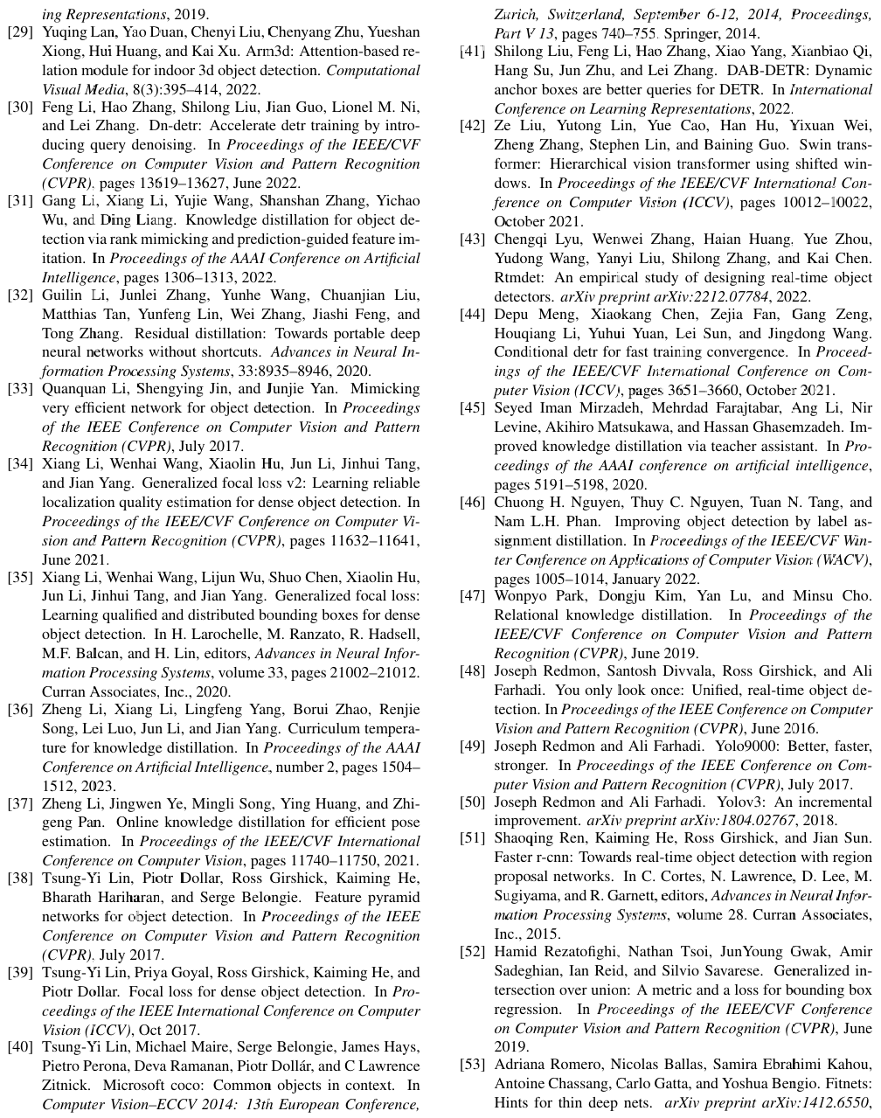
Reference

Slide 29
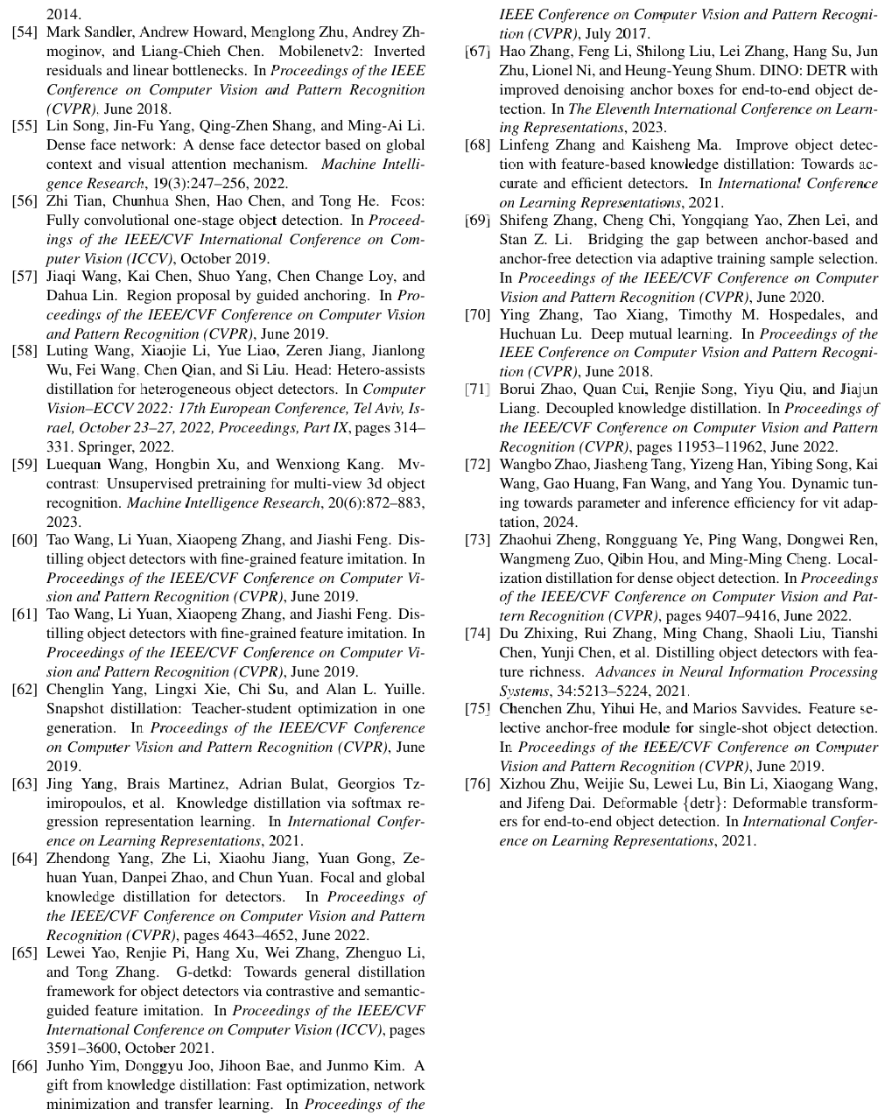
Reference

